Slide 2
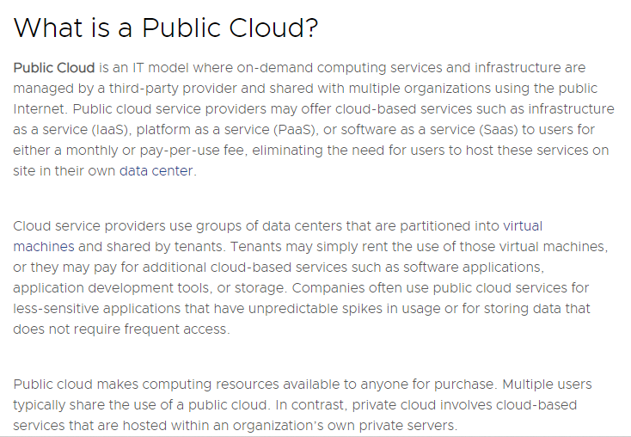

Slide 3
Why Public Cloud?
Many enterprise businesses look to the public cloud as a way to scale existing IT resources on demand without committing to expanding their physical IT infrastructure. For instance, instead of purchasing a physical desktop machine, a company can purchase a virtual desktop license. The virtual desktop can be spun up or deactivated in minutes and can be located anywhere, instantly.
The public cloud is also a popular solution for storage needs since data stored on a public cloud is backed up and accessible from anywhere. There are many different types of storage plans, and data that does not need to be accessed frequently can often be stored in the public cloud very cheaply.
For companies that host an application with periods of peak usage, the public cloud makes perfect sense because the extra computing power is only needed for a short time.
Using the public cloud can save businesses money in a couple of different ways:
Lower equipment purchase costs: Because employees can access and pay for cloud-based resources only when they need them, using public cloud-based desktops and applications is often less expensive than purchasing physical IT equipment or software packages that may or may not be used and will need to be maintained.
Lower equipment maintenance costs: With public cloud-based services, the cost of maintaining IT equipment is also passed on to the cloud service provider.
A small or new business may have an easier time migrating applications to the public cloud; organizations with a large legacy IT infrastructure and applications have more to consider and plan for. However, more and more enterprise businesses are moving toward the public cloud as one element of a multi-faceted IT plan. This way, they can access the benefits of the public cloud while also maintaining the different benefits that come with on-premises architecture and private cloud options.

Slide 4
Advantages of Public Cloud
Scalability
Public cloud services come with the auto-scaling feature. This means that all the virtual machines present inside the Public cloud system have the capability to get created, scaled, and shut down at an infinite speed. Therefore, ultimately the workload will be balanced according to the needs so that you can avoid downtime and crashes.
2. Cost
Since a third party provides the Public cloud services, there is no need for an IT employee to look after and maintain the system. The cost of bandwidth, hardware, and application is the sole responsibility of the provider. Hence, the initial investment here is almost zero. Moreover, Public cloud services follow the model of pay-as-you-go which means that the payment is made monthly or annually according to the way the resources are being used.
4. Reliability
Public cloud services offer greater reliability. This means there are very less chances of failure interrupting your service. The data center present on the network of servers can undergo frequent failure. Even if it does so, it will not be an issue since the workload will be distributed among the remaining data centers.
5. Data Recovery
A Disaster recovery plan is generally difficult and complex to deploy. That is the reason why most IT companies don't consider this implementation. However Public cloud has very little risk of losing data here. This is because most of the multiple infrastructures are available in the Public cloud services.

Slide 5
Disadvantages\ Limitations of Public Cloud
1. Low Security and control
The security and privacy of data present inside a Public cloud service remain a concern for many businesses. The Public cloud services offered by many providers are secure to some extent. But the problem lies within the company and how they are going to use them. Therefore, companies must make use of cyber security practices. And also trust in the third party provider is also questioned since they can be from different countries having their own set of security and privacy regulations.
2. Flexibility
Even though Public cloud services are very flexible in terms of scalability, there are issues with security and configurations. Some Public cloud providers do not grant freedom to install an operating system or switch storage solutions. That is the reason why Public cloud services are not recommended for organizations with compliance regulations.
3. No Control
Using the Public cloud services means that you are sharing the same infrastructure with the other customers. The maintenance and management have been entirely taken care of by the service provider. The users have no control over it.
4. Customization
The atmosphere of the Public cloud service can limit any customization process. Hence, customization of resources or services is almost made impossible in a Public cloud service. This can be disadvantageous, especially to companies with complex network architecture and application processes.
5. Customer Support
Public cloud models lack on the side of customer support. In fact, it is a separate contract for the client. Customer support is an important point to remember since some providers do not deliver quality service. Therefore, users need to discover solutions on their own.

Slide 6
Disadvantages\ Limitations of Public Cloud
6. One-size-fits-all solutions
When you sign up with a public cloud provider, you choose an existing package of services. This generic approach to IT services keeps costs down, but it hasn’t been tailored to your business, which could be a nightmare if you’ve got a complicated network architecture. You’ll have the exact same solution as the rest of the cloud customers, with little scope for this to adapt to your business. It might be unable to support your business if your requirements stray too far from the set dimensions of your public cloud.
7. Limited visibility
The view you have of your data will be through whatever portal is provided by your public cloud host. If you want more information than is displayed, there’s nothing you can do. While there is probably nothing underhand going on, it’s an undeniable disadvantage of the public cloud that you won’t have complete visibility on all the metrics of your data storage. We’re living in an age of information, and the more data you have, the better equipped you’ll be to make business-critical decisions. Being ignorant of certain information is never a part of anyone’s IT plan and might leave your business in the dark.
8. Outgrowing the platform
The public cloud is well suited for businesses that are starting out or growing rapidly. But public cloud services are intended to be a flexible alternative to other data storage, so once your IT system grows large enough and your priority is now capacity over flexibility, it’s no longer cost-effective to stay on the public cloud. Dropbox reportedly saved nearly $75M over two years by moving off of the public cloud and into colocation services hosting private hardware. You will outgrow your public cloud platform eventually and need to make sure you don’t lose out financially by staying on it for too long.
9. Unreliable services
Even the biggest cloud providers still suffer downtime, whether it’s Google, Microsoft, or AWS. It’s an unavoidable fact of life, but if there’s a lack of communication and a slow fix, then that’s an unnecessary disruption to your business. Ultimately, it’s your IT that matter to your business, so if you’re regularly experiencing problems, your provider's overall performance doesn't matter. You need to be able to quickly access the engineers responsible for your systems when something goes wrong, to find a fix as soon as possible. With a large and complicated shared public cloud system, getting to the root of the issue can be a slow process

Slide 7
Disadvantages\ Limitations of Public Cloud
7. Compliance issues
Ever since GDPR came into effect, businesses have been more aware of compliance issues around storing personal or sensitive data. If you work in an industry with a focus on data compliance – like banking, healthcare, or countless others – then this takes on extra importance since you can’t let a lack of data compliance lose your business. The lack of control with the public cloud makes it difficult to meet data regulation requirements, which is why a lot of businesses use the private cloud or their own hardware for storing sensitive data.
8. Unpredictable costs
Public cloud services offer a “pay as you go” and “pay for what you use” billing format, which is great for small businesses with variable usage. However, it can cause a nightmare for your accounts department with how unpredictable it is. It’s easy to create some extra workload and suddenly be over budget, which can quickly eat into the profits of your business. This is a disadvantage unique to a public cloud since almost all other IT infrastructure solutions will have a set monthly cost.
Is the public cloud right for your business?
Reviewing the pros and cons of the public cloud is essential to understanding if it’s a good fit for your business or not. Unfortunately, if your business prioritizes security, has specific IT requirements, or needs to get spending under control, then the public cloud won’t be a good fit for you, especially in the long term.
Instead, you could look at a private cloud solution, which still provides a lot of support but with better security and fixed costs. Or you can get the best of both worlds and look at a hybrid IT system, where you can keep the flexibility of your public cloud but combine it with a more secure and reliable IT platform.

Slide 8
The high cost of accessing the public cloud for Long-Term
The actual storage fee for housing your data in the public cloud is typically low. But once your data is in there, you must pay to access it, which for many comes as a surprise. That means the more value you get from your data, the more money you have to pay. Although these charges are considered low (in the range of $0.01 to $0.05 per 1,000 transactions) costs can quickly escalate when a customer is using the public cloud as primary storage or for storing any particularly active data set.
Public cloud vendors also charge for a variety of services besides just storing your data. You need to not only be aware of these costs but also do a cloud storage cost analysis to really understand your costs before moving your data to the public cloud.

Slide 9
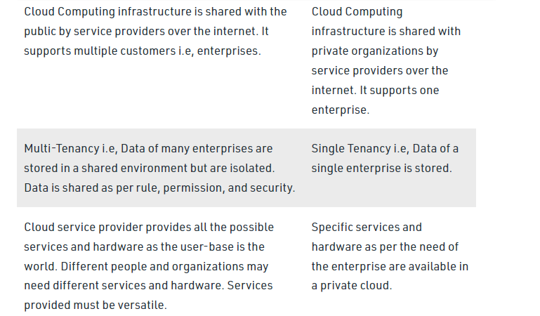
Differences

Slide 10
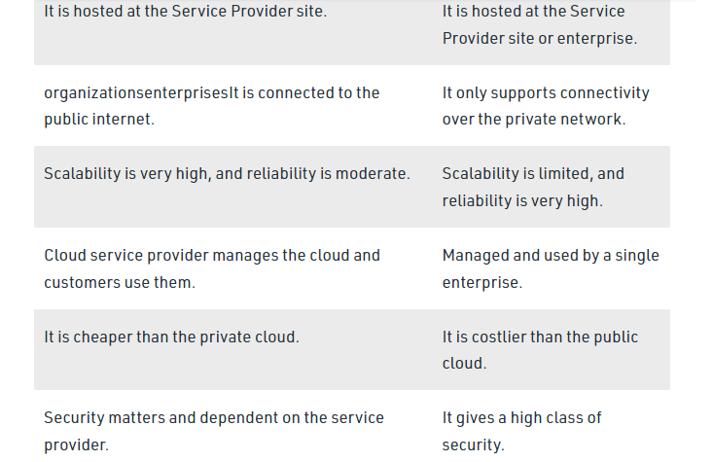
Differences

Slide 11
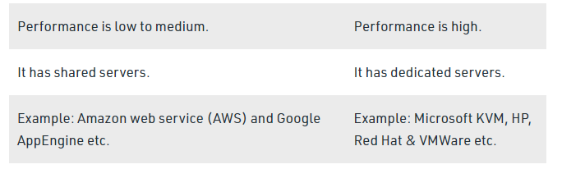
Differences

Slide 12
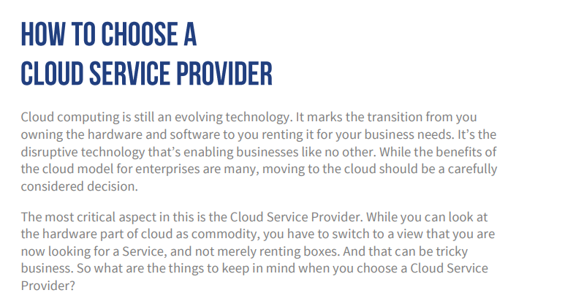
Vendor Selection:

Slide 13
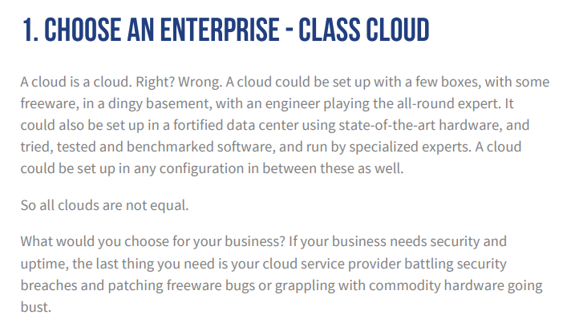
Vendor Selection:

Slide 14
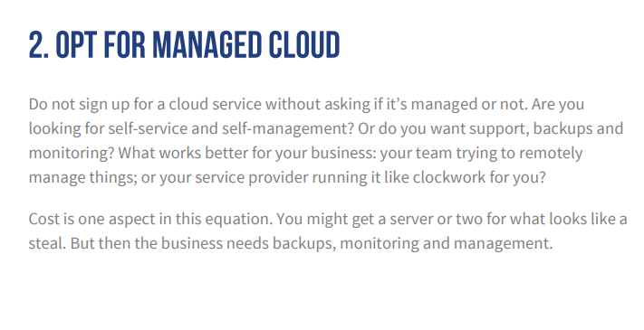
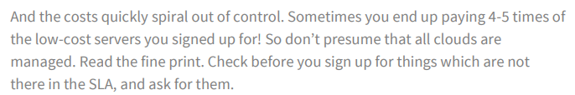
Vendor Selection:

Slide 15
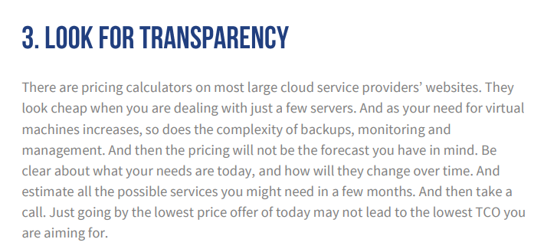
Vendor Selection:

Slide 16
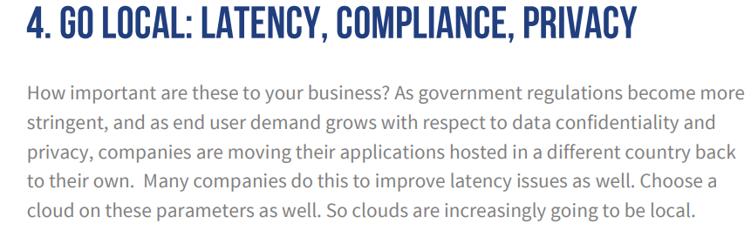
Vendor Selection:

Slide 17
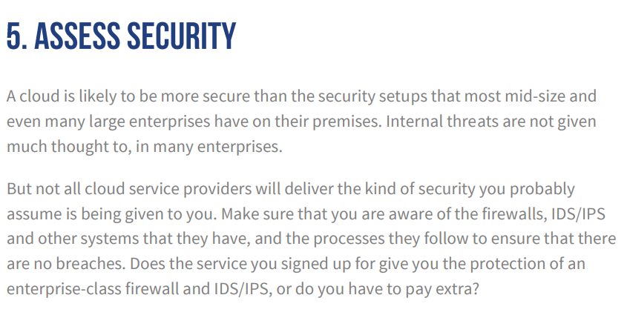
Vendor Selection:

Slide 18
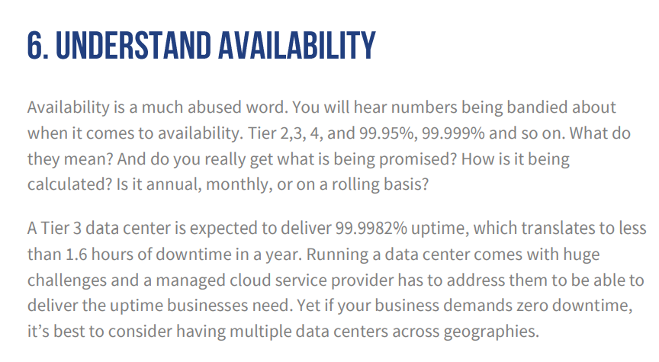
Vendor Selection:

Slide 19
What is cloud migration?
Cloud migration is the process of moving a company’s digital assets, services, databases, IT resources, and applications either partially, or wholly, into the cloud. Cloud migration is also about moving from one cloud to another.
Companies wishing to move on from outdated and increasingly inefficient legacy infrastructures, such as aging servers or potentially unreliable firewall appliances, or to abandon hardware or software solutions that are no longer operating at optimum capacity, are now turning to the cloud to experience the benefits of cloud computing. This is why so many organizations are, at the very least, making a partial migration to the cloud.
We know that cloud migration is critical for achieving real-time and updated performance and efficiency. As such, the process requires careful analysis, planning, and execution to ensure the cloud solution's compatibility with your business requirements.
When considering your strategy for migrating to the cloud, it’s important to understand that it’s not just about getting there, it’s also about what you do when you get there. For instance, what are your options for rebuilding applications so they can perform optimally in the cloud? The process of cloud migration is making companies ask the question: what is application modernization?
There are many questions to be answered along the way, and businesses of all sizes require assistance in making their cloud journeys. Consequently, many services firms can make a strong case for their lift-and-shift cloud migration capabilities, or their classic modernization services, such as automated language translation and conventional re-platforming.

Slide 20
What are the benefits of cloud migration?
For companies that undertake the process of cloud migration, the cloud can have a massive impact.
This includes a reduction in the total cost of ownership (TCO), faster time to delivery, and enhanced opportunities for innovation. With access to the cloud comes agility and flexibility, both of which are imperative to meet changing consumer and market demands.
In recent months, companies have been migrating their services and data to the cloud as they adapt to become elastic digital workplaces to deal with an increase in online demand and remote working. For businesses that have already begun the move to cloud computing, they're accelerating a cloud transformation that will lead the way forward in the years to come.
Benefits of migrating to the cloud include:
Increased agility and flexibility
Ability to innovate faster
Ease of increasing resource demands
Better management of increased customer expectations
Reduction in costs
Deliver immediate business results
Simplify IT
Shift to everything-as-a-service
Better consumption management
Cloud scalability
Improved performance

Slide 21
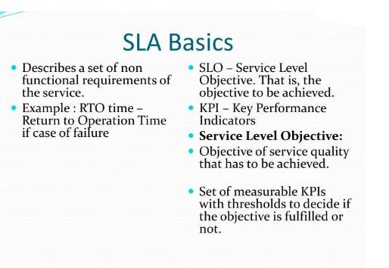

Slide 22
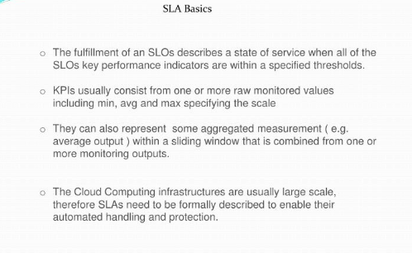

Slide 23
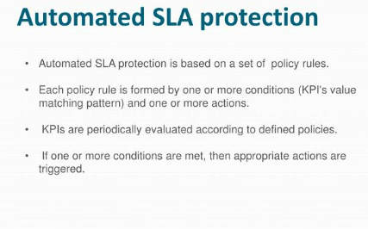

Slide 24
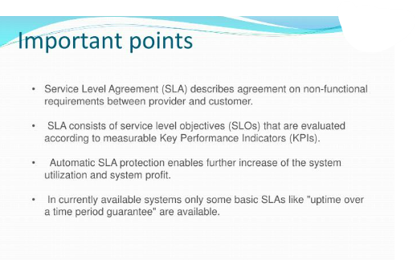

Slide 25
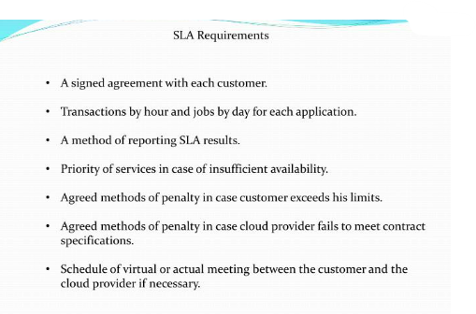

Slide 26
Compensation within the SLA
For the effective implementation of the SLA, there should be an element that covers the consequences of not meeting the said standards or requirements. The results will have a financial impact and be spelled out in the agreement.
For instance, the agreement provides for reporting services like a financial report with an accuracy of 95%; the contract must state the economic impact for non-adherence to the standard, like for three consecutive failures, a deduction of 10% from the fess or so.

Slide 27
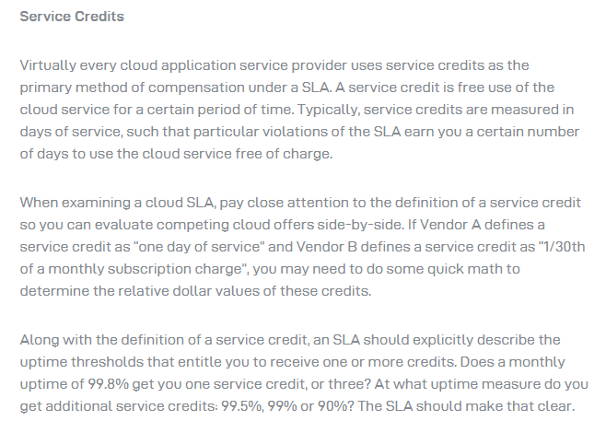

Slide 28
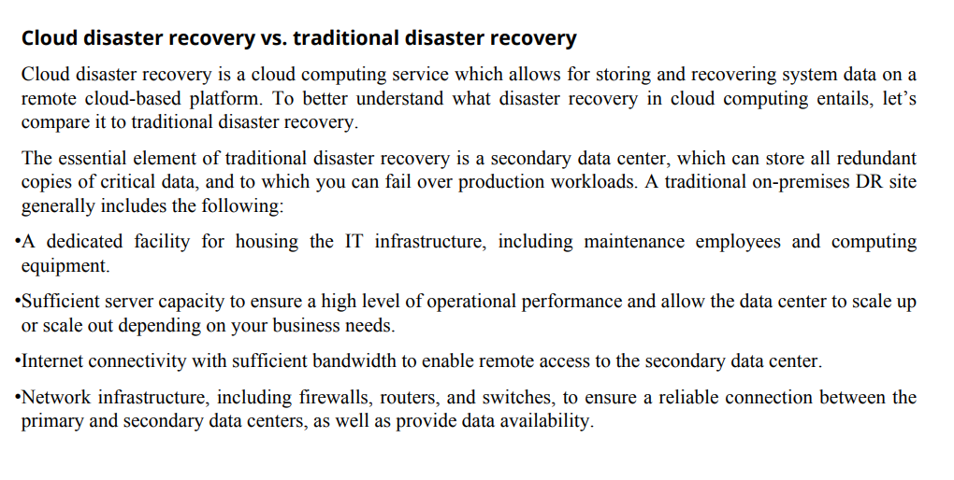

Slide 29
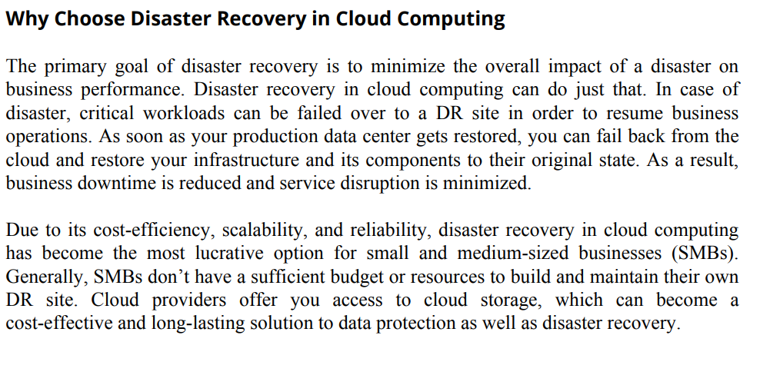

Slide 30
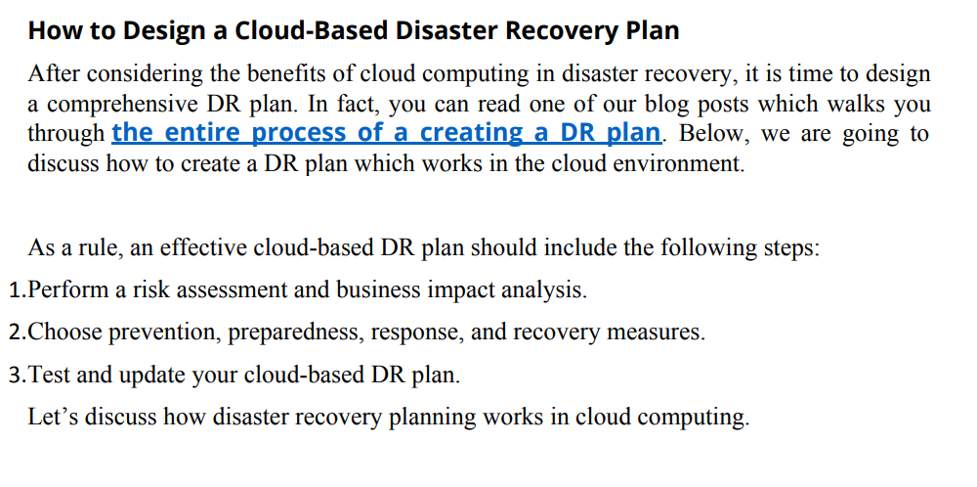

Slide 31
The Security Issues and challenges of Cloud Services
Password Security Industrious: password supervision plays a vital role in cloud security. However, the more people you have accessing your cloud account, the less secure it is. Anybody aware of your passwords can access the information you store there. Businesses should employ multi-factor authentication and ensure that passwords are protected and altered regularly, mainly when staff members leave. Access rights related to passwords and usernames should only be allocated to those who require them.
Data privacy: Sensitive and personal information kept in the cloud should be for internal use only, not to be shared with third parties. Businesses must have a plan to securely and efficiently manage the data they gather.

Slide 32
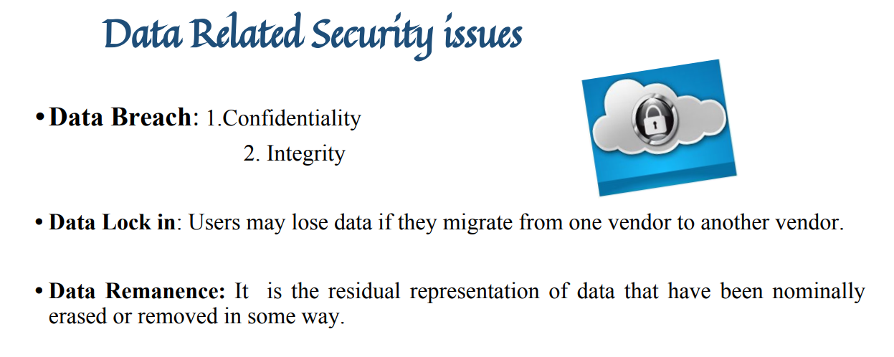

Slide 33
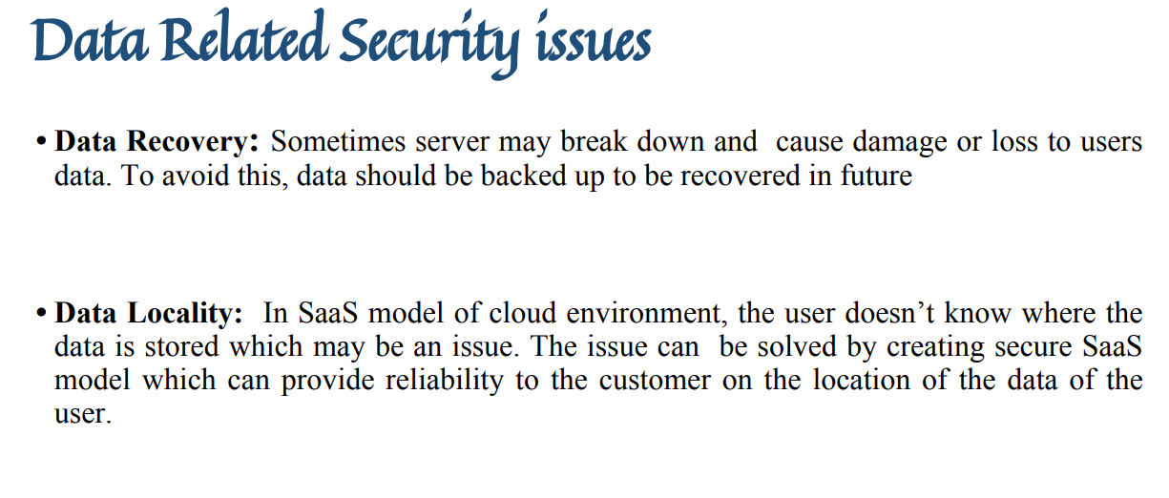

Slide 34
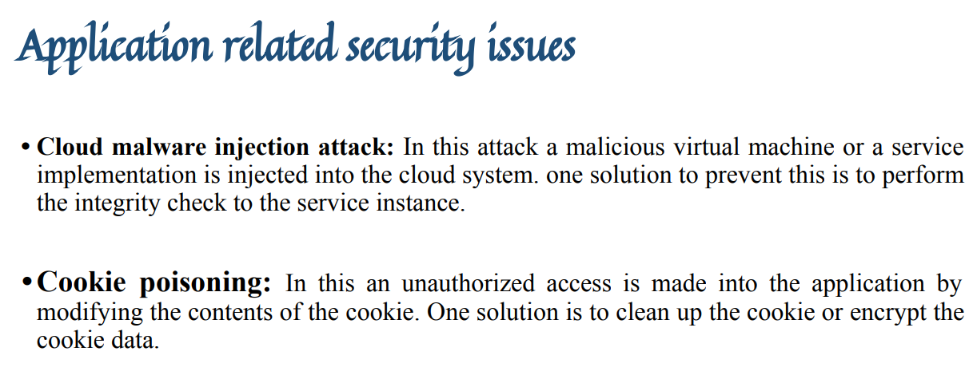

Slide 35
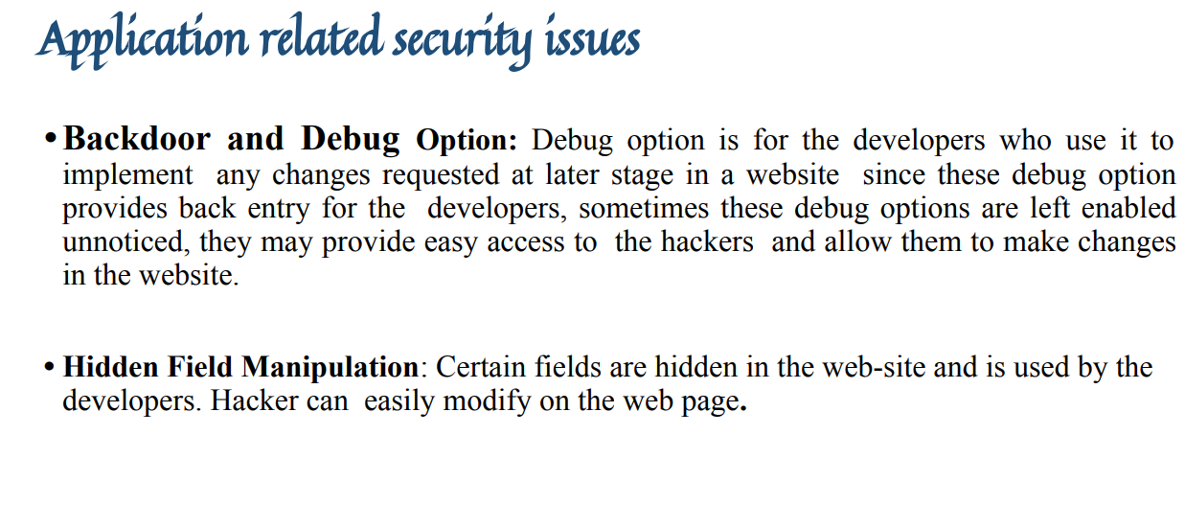

Slide 36
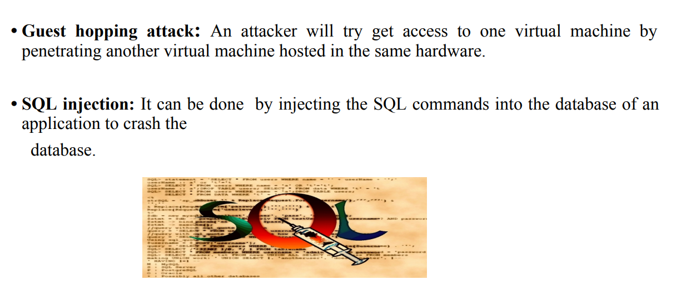

Slide 37
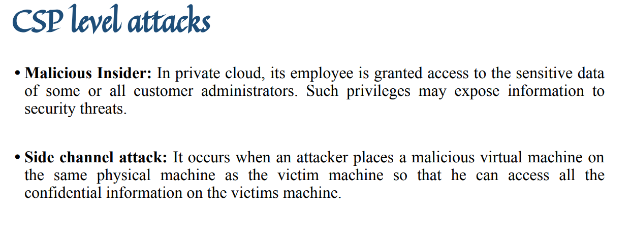

Slide 38
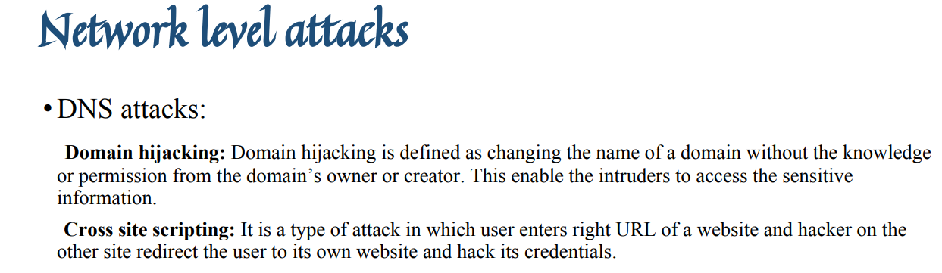

Slide 39
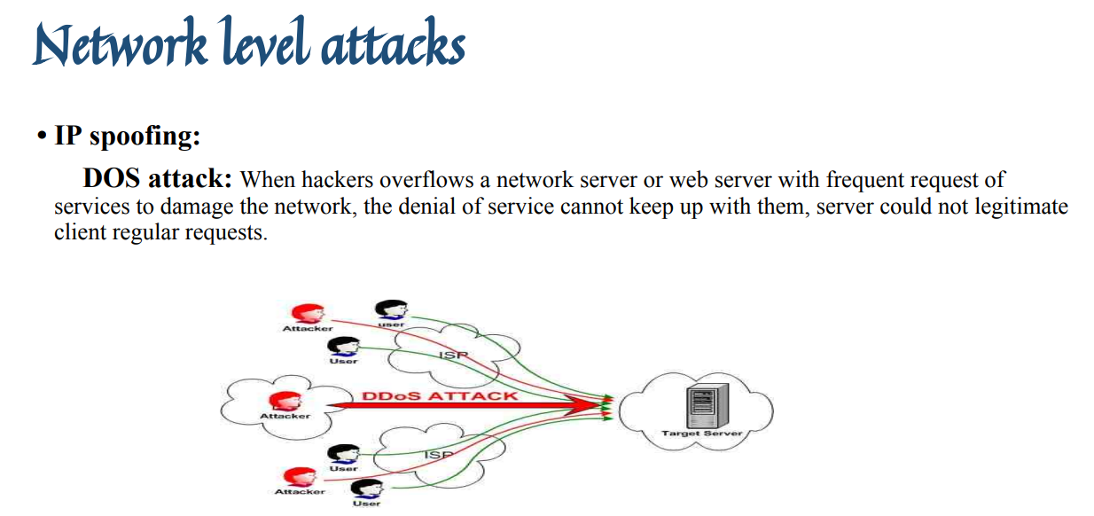

Slide 40
